Slide 1
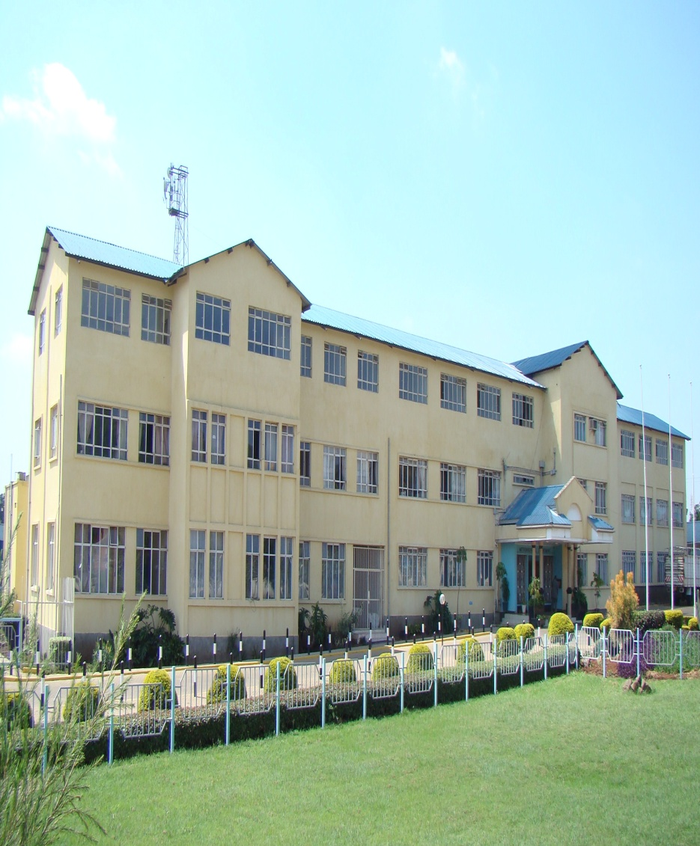
KENYA METEOROLOGICAL DEPARTMENT (KMD)
Climate Services –GAW Section
KMD Headquarter, Dagoretti Corner, NAIROBI

Slide 2
GLOBAL ATMOSPHERIC WATCH
KMD in collaboration with WMO operates two GAW Stations in Kenya. These are:
Nairobi GAW Station and
Mt. Kenya GAW Station.
Nairobi GAW station is situated within Nairobi City at the KMD Headquarters at a height of 1795m ASL.
Mount Kenya GAW station is situated within
Mt. Kenya National park at a height of 3600m ASL.

Slide 3
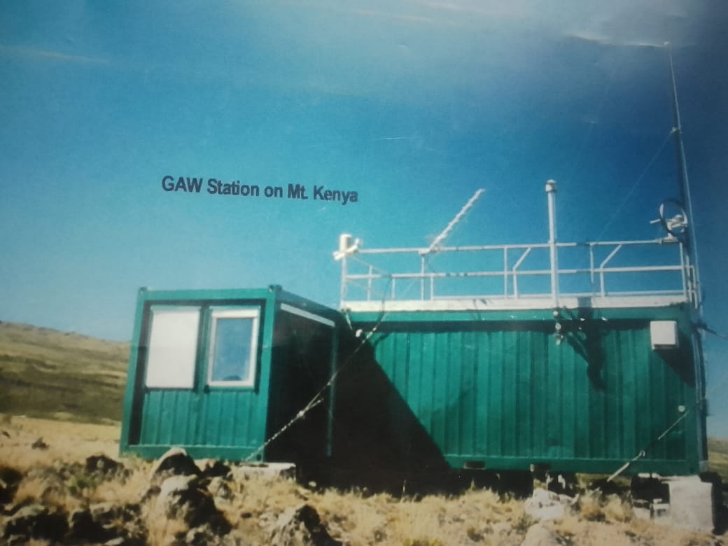
MT. KENYA GAW STATION

Slide 4
FUNCTIONS OF GAW
To monitor Tropospheric and Stratospheric Ozone.
To Monitor environmental pollution and green house gases for air quality assessment and climate change detection over Kenya.

Slide 5
GAW stations in Kenya are global stations and was started in the year 1999.
It is responsible for the measurements Of:
Ozone (Surface, TCO & Vertical profile)
Weather parameters
Black carbon
Carbon monoxide
Nitrous Oxide
Sulphur dioxide
Methane
Particulate Matter(PM10, PM2.5)/Particles Count
Aerosols

Slide 6
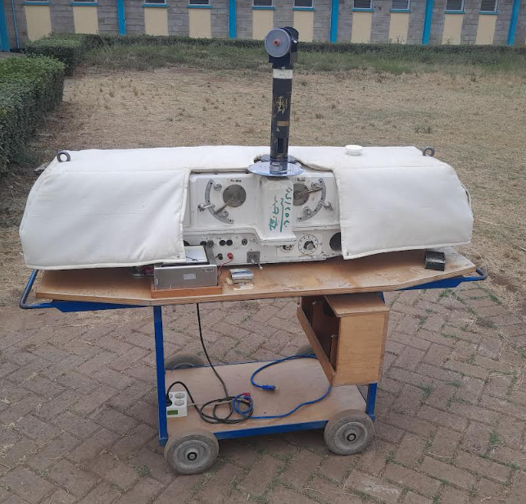
DOBSON SPECTROPHOTOMETER (D018)

Slide 7
The Total Column Ozone measurement is done using the Dobson Spectrophotometer.
Two types of observation are carried out:
Direct Sun (DS) Observation
Zenith Cloud (ZC) Observation
The ratio between the intensity of UVA and the UVB reaching the ground is used to determined amount/concentration of the Ozone in the total column of the atmosphere.
This is incorporated with the Beer Lambert's law:
A=ꜫ.C.L

Slide 8
Data is collected four times on a daily basis:
(0900hrs, 1100hrs, 1400hrs, 1500hrs)
The data is fed into an O3Dobson software which is able to give average values for the daily, the monthly and yearly averages.
We carry out lamp tests on the Dobson Spectrophotometer to Calibrate it on a weekly basis to ensure data quality.
We also take the Dopson for international intercomparison. (Done June 2025).

Slide 9
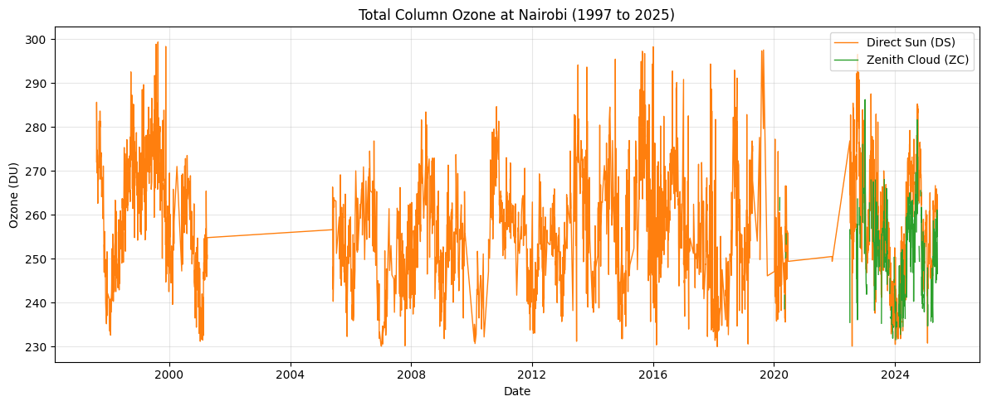
Below is a data history for the daily average Total Column Ozone observations from D018 from 1997 to 2025 in Nairobi station.

Slide 10
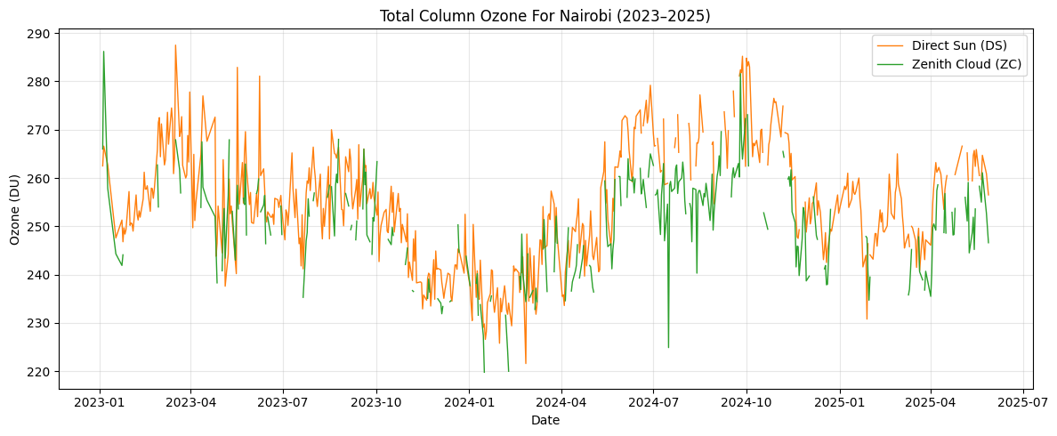
Below is a plot of Total Column Ozone time series from 2023 to 2024 for NRB station.

Slide 11
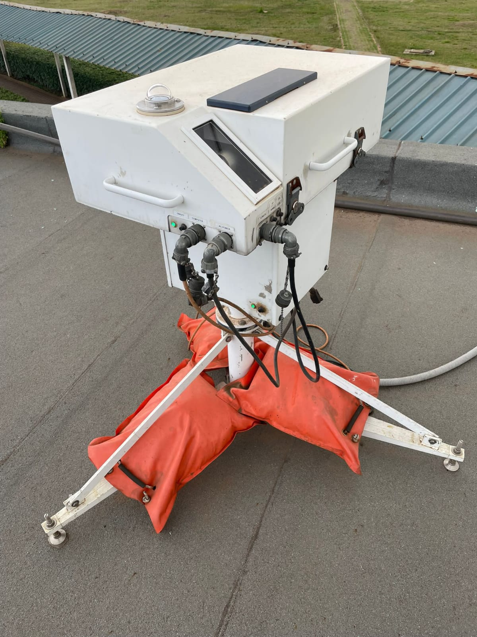
THE BREWER SPECTROPHOTOMETER (#071)

Slide 12
This is an automatic instrument placed on an open roof that measures total column Ozone.
The instrument tracks the spectrum of the sun throughout the day and sends the measurements to a receiver.
The display consists of ozone averages for the day and a graphical display of the measurements real time.
The data is also transmitted to the World Data Center.

Slide 13
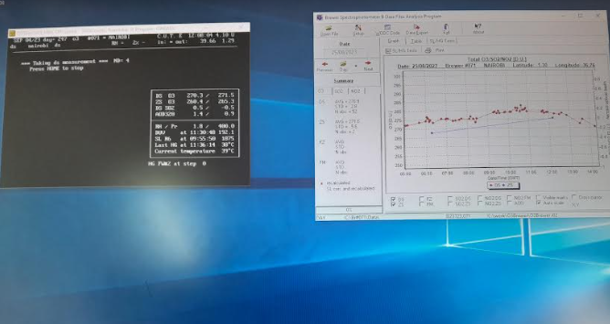
This a display of the software that runs the Brewer and also the data graphic presentation of the real time data.

Slide 14
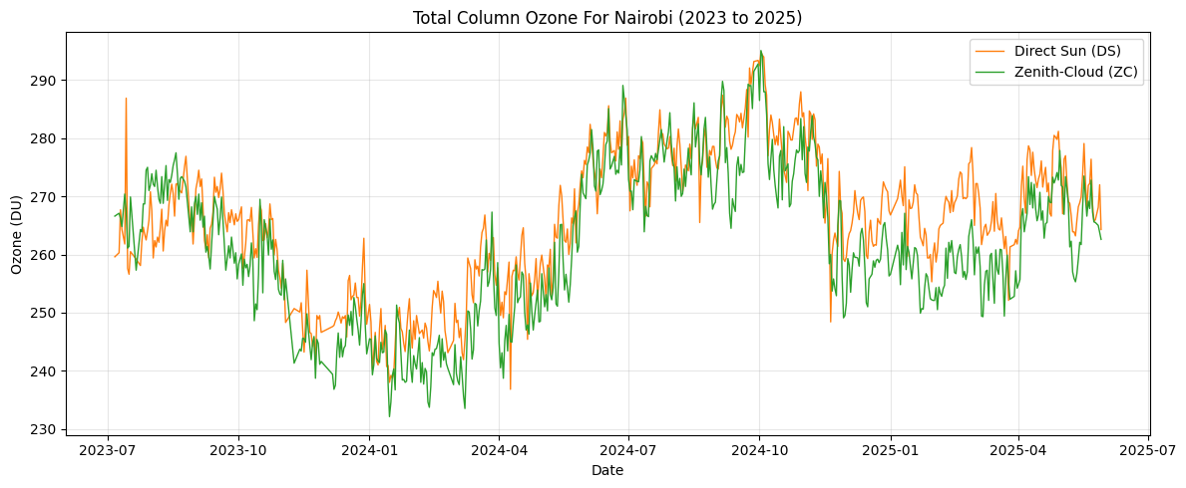
Below is a plot of the daily average total column O3 from Jan to May 2025. Data obtained from the Brewer Spectrophotometer(NRB Station).

Slide 15
From both the Dobson and Brewer spectrophotometers:
Between July 2023 and July 2025, Nairobi’s total column ozone oscillates roughly between 230 DU and 310 DU, driven by a semi-annual cycle with maximum in March–April and September–October and minimal in June–July and December.
The total column O3 data is highly used to validate satellite data.

Slide 16
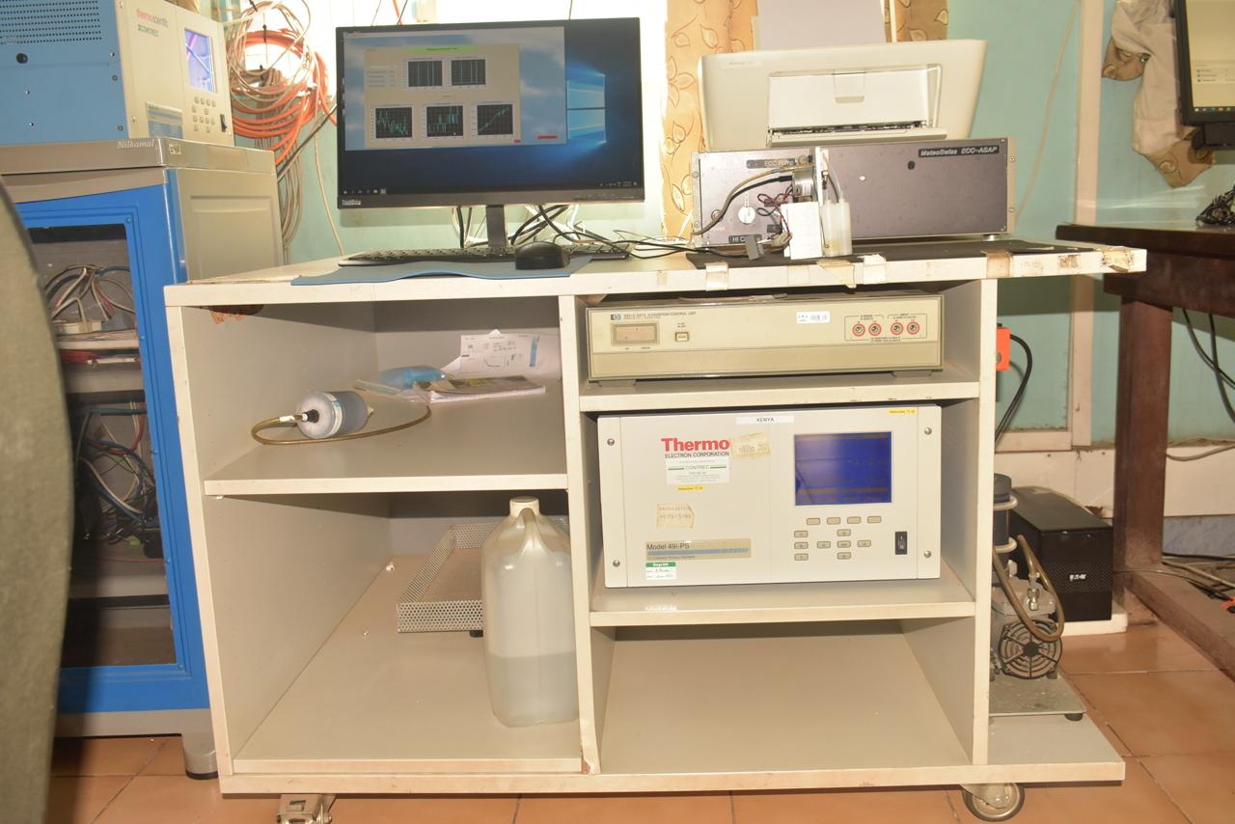
THE OZONE SONDE

Slide 17
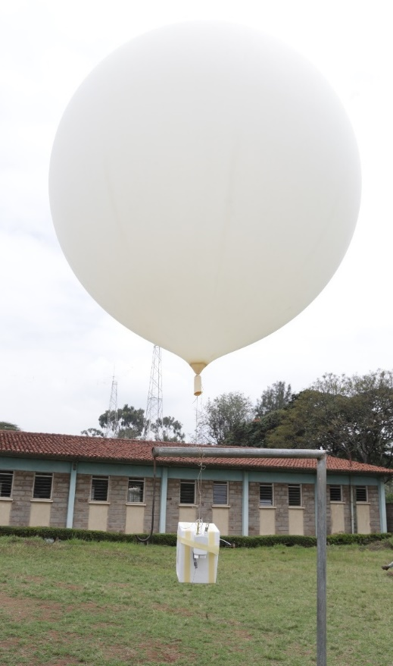
THE OZONE SONDE LAUNCH

Slide 18
VERTICAL PROFILE OZONE MEASUREMENT
Done using the ECC coupled with the radiosonde and launched using the balloon filled with Hydrogen gas.
Ozone sensor is Potassium Iodide Solution contained in an Electro Chemical Cell (ECC)
It’s launched once in a week on Wednesday noon.
There is real time data display via a digicora receiver to a computer.

Slide 19
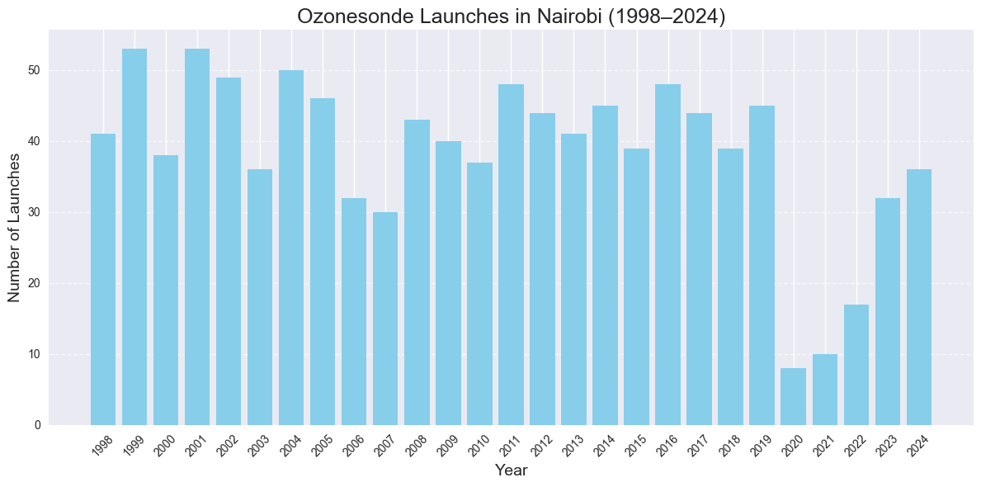
Below is a presentation of data history for Ozone sonde launches in NRB station (Over 1100 Launches).

Slide 20
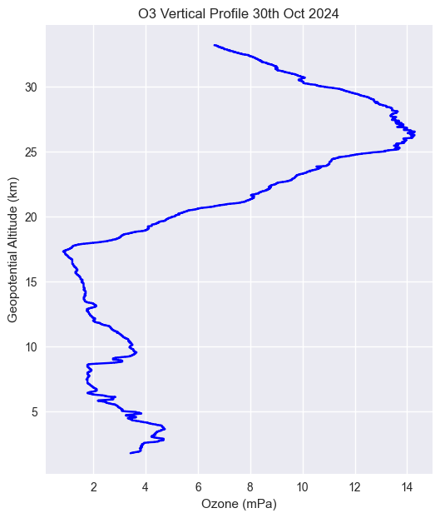
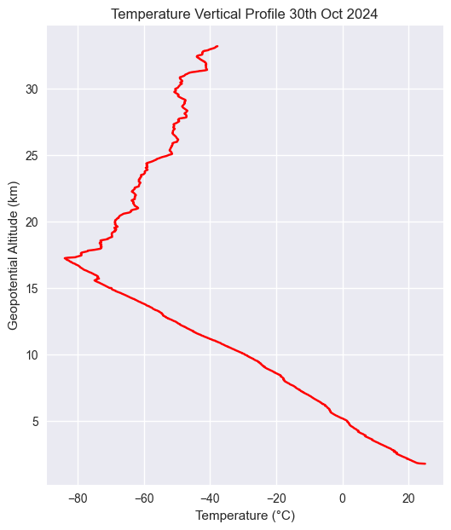
Below are plots for O3 vertical profile & Temp vertical profile from data collected at NRB station.

Slide 21
Ozone concentration rises from 1 mPa at the surface, climbing through the troposphere to a peak of 12–14 mPa around 25–30 km (stratospheric maximum).
Temperature drops from 15 °C at ground level to –60 °C near 12 km (tropopause), then increases steadily to –10 °C by 30 km (stratospheric warming).
Correlation:
Below the tropopause, both ozone and temperature decrease with height but without a tight causal link.
Above the tropopause, higher ozone coincides with rising temperatures. Ozone’s UV absorption drives the stratospheric temperature inversion.

Slide 22
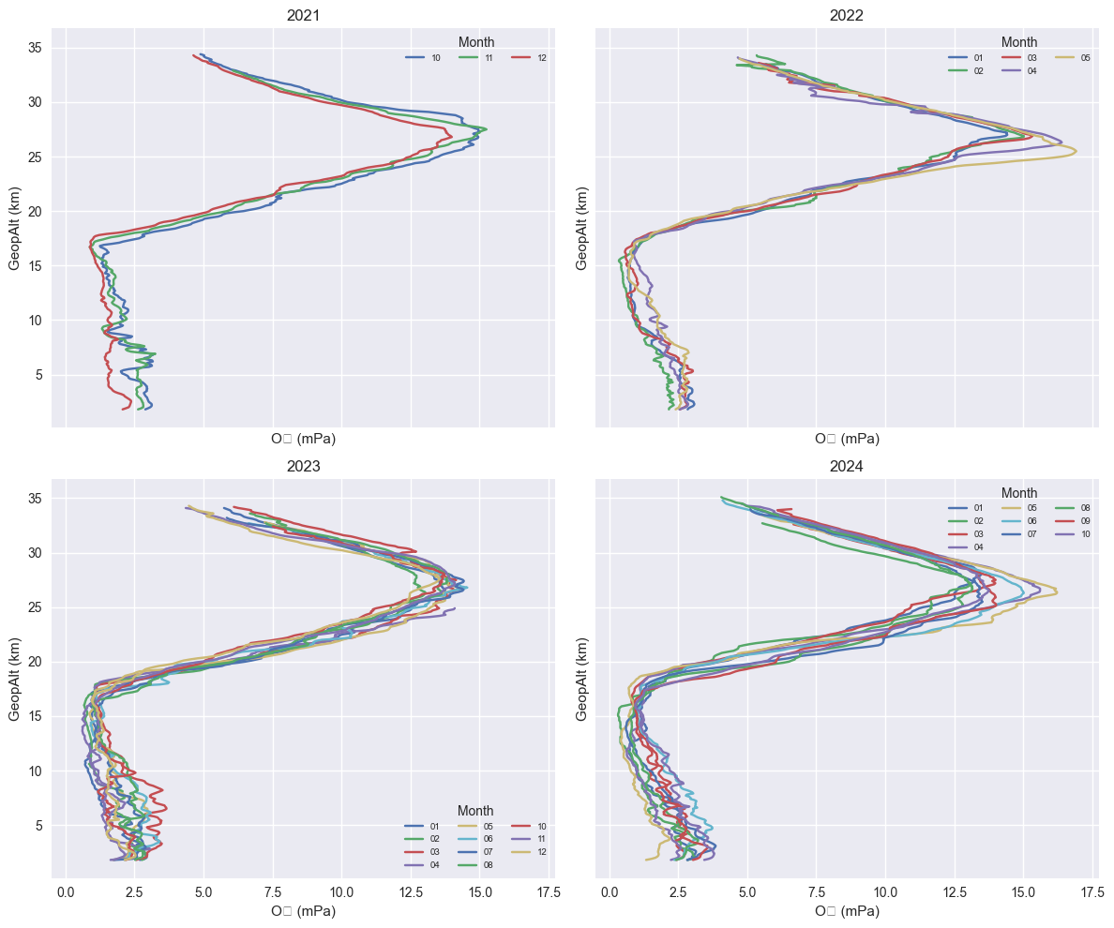
Below are plots for monthly average O3 vertical profiles from 2021 to 2024 data collected at NRB station.

Slide 23
From the four years plot (2021-2025), generally, Year-to-year comparisons show that peak ozone values and profile shapes remain within ±0.5 mPa of one another at all altitudes.
There is no systematic upward or downward shift in these peaks over the four-year span, indicating that, in NRB station, the ozone layer has remained essentially stable rather than clearly improving or deteriorating.

Slide 24
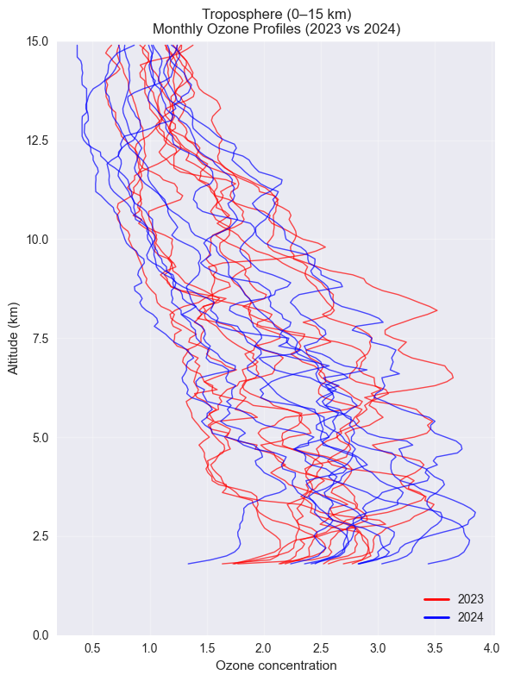
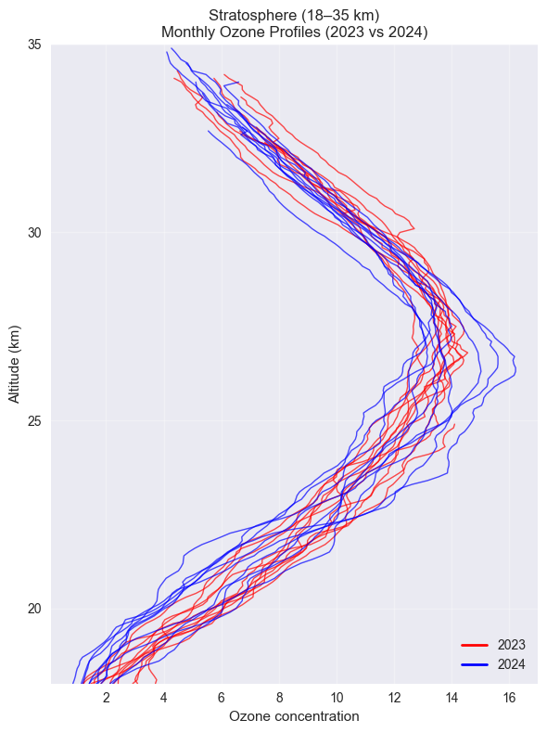
Below is plot for Tropospheric & Stratospheric monthly average O3 vertical profiles from 2023 to 2024.

Slide 25
TROPOSPHERIC OZONE (0–15 km):
Monthly mean ozone hovers around 30–40 DU with a slight positive slope.
Indicates modest surface‐level ozone increase, likely tied to urban emissions and stronger photochemistry during dry seasons.
STRATOSPHERIC OZONE (18–35 km):
Strong upward trend, rising from 95 DU in early 2023 to 110 DU by late 2024.
Suggests continuing stratospheric ozone layer recovery following global reductions in ozone‐depleting substances.
Stratospheric gain is positive for UV‐shielding; continued monitoring validates policy successes (Montreal Protocol).
Global Atmospheric Watch (GAW)

Slide 26
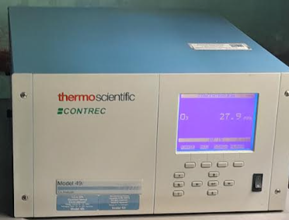
THE THERMOSCIENTIFIC
O3 ANALYZER MODEL 49i

Slide 27
This is an automatic instrument that measures surface Ozone and transmits the measurements automatically to the Data processing Center.
It measures the surface O3 in PPB.
All the data obtained through these measurements is quality controlled and then transmitted to the World Data Centre and also archived in our Data Centre.
We measure surface O3 in both Nairobi & Mt. Kenya stations.

Slide 28
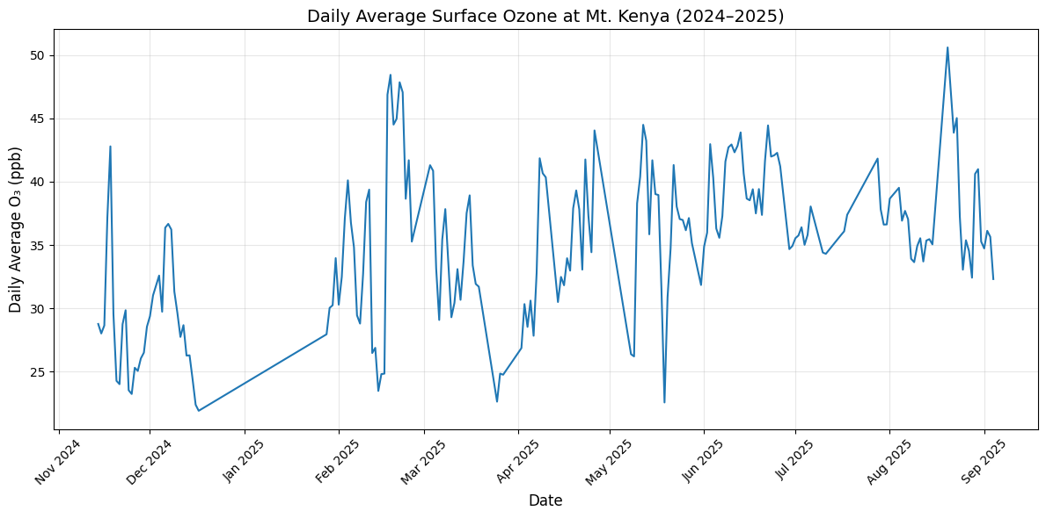
Below is a plot for the daily average surface O3 time series for Mt. Kenya station from Nov 2024 to Sept 2025.

Slide 29
Between November 2024 and September 2025, daily surface O₃ at Mt. Kenya oscillated between 20 ppb and 45 ppb, with clear seasonal highs in March–April and lows in June–July.

Slide 30
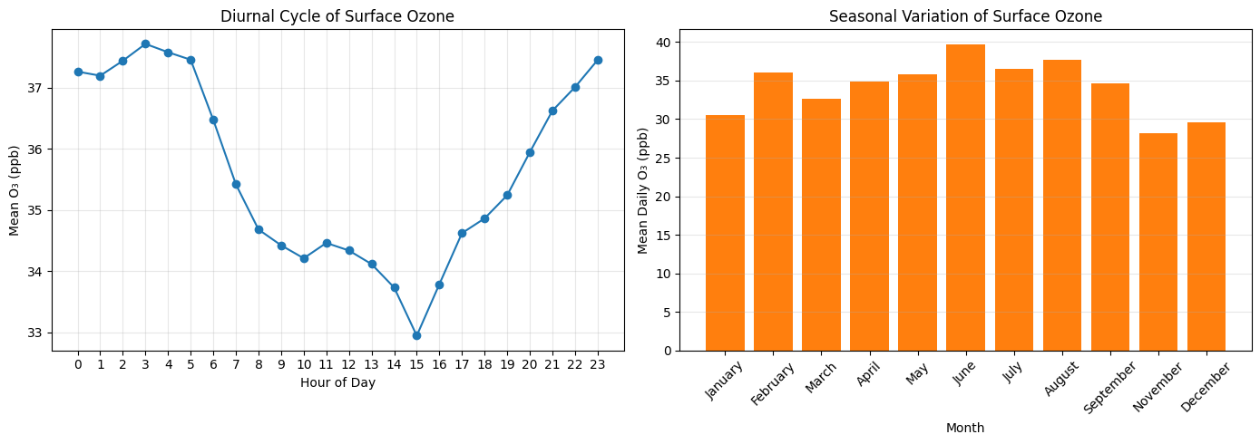
Below are plots for the diurnal cycle & seasonal variation for surface O3 for Mt. Kenya station.

Slide 31
For the diurnal cycle:
Ozone peaks around midnight at about 37 ppb (no photochemical titration of O3 happening).
It drops to its lowest near 1400hrs at about 32 ppb (due to photochemical titration).
For the seasonal variation :
Seasonally, mean daily O₃ is lowest in December–January (20 ppb) and rises steadily to a maximum in May–June (45 ppb) before declining again, driven by changes in solar radiation and precursor emissions.

Slide 32
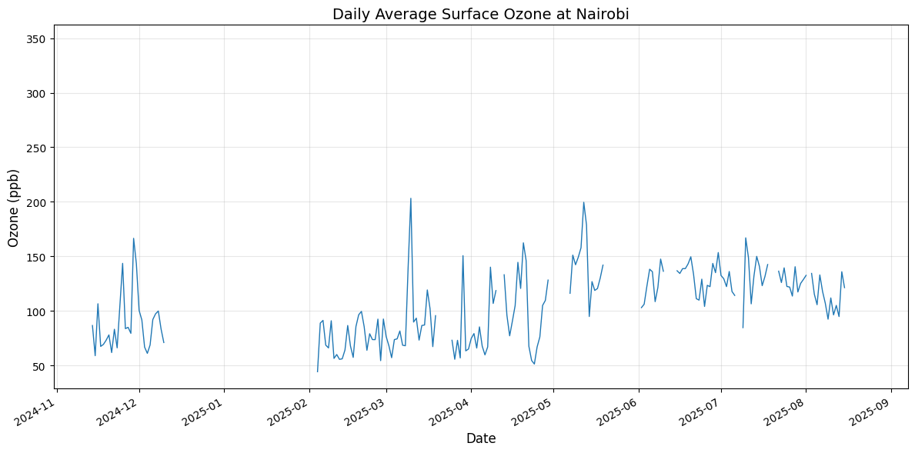
Below is plot for a daily average surface O3 time series for Nairobi station (2024 to 2025).

Slide 33
Seasonal pattern:
Lowest averages occur during the long rains (March–May), dipping toward 20–30 ppb
Highest sustained levels appear in the dry season (June–September) and the short dry spell (January–February), often 50–80 ppb

Slide 34
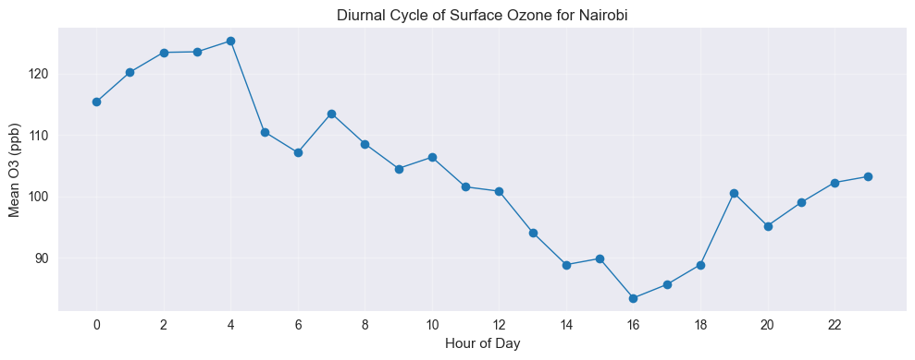
NRB station Surface O3 diurnal cycle:

Slide 35
-END- THANK YOU!

